Slide 1
Climate & Human

Slide 2
AIM
To navigate user to the least polluted route possible
How environment affect human health
How human everyday activities affect environment.

Slide 3
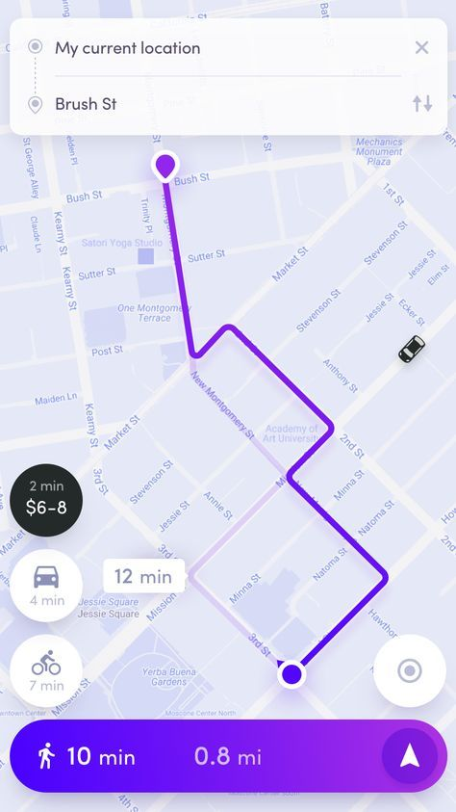
Navigation
Input from user :
Source
Destination
Output :
Least polluted route

Slide 4
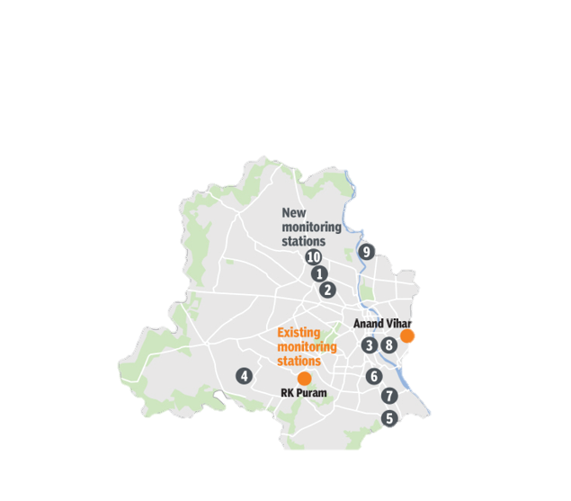
Environment → Human
Detect pollution level of the area
Insight Gain
Categorise areas based on pollution levels
Predict health risk of individual

Slide 5
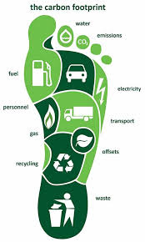
Human → Environment
Detect the human’s everyday activity such as vehicle usage, running etc. and calculate the carbon footprint.

Slide 6
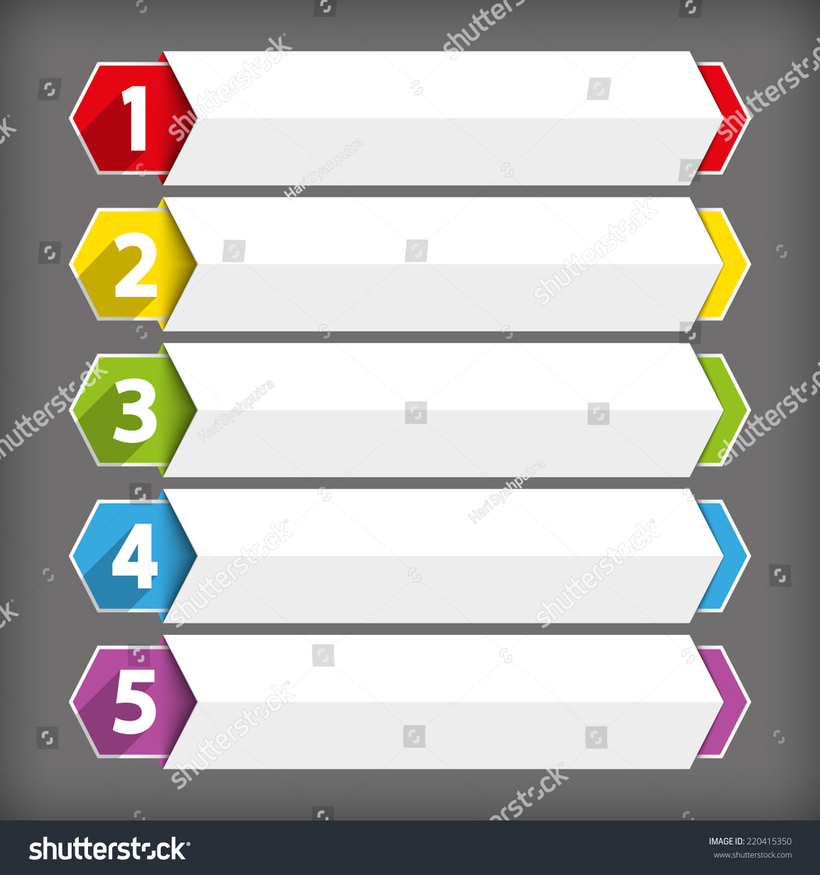
Future Scope
Our Application will give score to user based on their activities and user can challenge their friends to improve their ranking on our scoreboard.

Slide 7
Predict Health Risk
register
login
Get Current location
Check Air/Noise Quality Index
Classify Areas
Navigation
Get least polluted Route
Existing user
Rank in Carbon Footprint
Scoreboard

